Slide 1

MSCI 311
Organizational Design and Technology
Instructor: Ayman Alzayat, aalzayat@uwaterloo.ca
TA: Varsha Suryanarayana, vsuryana@uwaterloo.ca

Slide 2
Decision Making
Rational Approach
Individual Decision Making
Bounded Rationality Approach
Intuitive Approach
Decision Making
Management Sciences Approach
Organizational Decision Making
Carnegie Model
Garbage Can Model
(Chapter 8 in the Textbook)

Slide 3
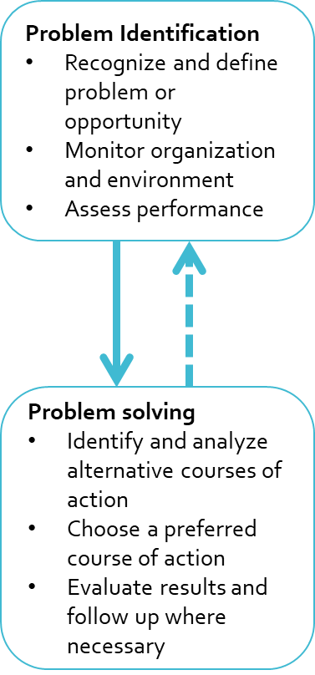
What is decision making?
“Choosing a course of action for dealing with a problem or opportunity”
Q: Can decision making reduce uncertainty?
Two key stages:
Problem identification (i.e., recognize and define the problem)
Problem solving (i.e., identify alternative actions and choose one)

Slide 4
There are two types of decisions:
Programmed decisions
Standard responses for solving routine problems (e.g., response to request for extension on assignment)
Non-programmed decisions
Responses to novel (non-routine), poorly-defined problem situations (e.g., response to request for accommodation due to divorce)
Every programmed decision used to be a non-programmed decision.

Slide 5
Information and Decision Making
The value of information depends on its ability to influence decision making. Relevant characteristics of information include:
Quantity of information (received, wanted, or needed)
Cost (e.g. pay for data from Statistics Canada or other sources)
Value (and marginal value)
Richness of information
Carrying capacity of a particular method of conveying information (e.g., face-to-face vs. e-mail)
Timeliness of information (e.g., forecasting demand)
Quality of information (e.g., credibility of the source)

Slide 6
Individual decision making approaches
1. The Rational (or Economic) Model
The Rational (or Economic) Model of decision making prescribes a structured way through which the individual can make decisions.

Slide 7
Individual decision making approaches
1. The Rational (or Economic) Model
(example (engineering) design)
Perceiving a gap
Diagnosing the problem
Developing alternative solutions
Evaluating alternatives
Choosing the best alternative
Defining the problem
Implementing the alternative

Slide 8
Individual decision making approaches
2. The Bounded Rationality Perspective (H. Simon)
It’s impossible to make perfectly rational decisions because decision maker has “finite cognitive capacity”
People exhibit “subjective rationality” in their judgment, which has the following (and more!) characteristics:

Slide 9
Individual decision making approaches
2. The Bounded Rationality Perspective (H. Simon)
A - Grouping of choices for simplification:
e.g. rather than deciding between all individual makes of cars, the available choices are first grouped and a decision is made at the group level: Japanese vs. European vs. Korean cars

Slide 10
Individual decision making approaches
2. The Bounded Rationality Perspective (H. Simon)
B - Assigning subjective probabilities to choices according to predictable biases. For example:
1- Insensitivity to sample size (or small sample bias)
2- Availability bias
3- Representativeness heuristics
4- Framing of the problem
5- Anchoring effect
6- Risk avoidance in gains and risk-seeking in losses
7- Confirmation bias

Slide 11
Individual decision making approaches
2. The Bounded Rationality Perspective (H. Simon)
B - Assigning subjective probabilities to choices according to predictable biases. For example:
1- Insensitivity to sample size: considering sample size is not part of our intuition unless it’s extreme
e.g., a child and hot stove, bad restaurant.
2- Availability bias (ease of recall): Information you use to make decisions is based on what you already know, or on examples that are recent, or that easily come to mind
e.g., changing your mind about buying a Dodge Grand Caravan after your neighbor tells you they had issues it

Slide 12
Individual decision making approaches
2. The Bounded Rationality Perspective (H. Simon)
B - Assigning subjective probabilities to choices according to predictable biases. For example:
3- Representativeness heuristics: Making judgments about a larger category based on information we have about a prototypical (representative) member of the category
e.g., BMW vs. Peugeot as more representative of European cars, a category called furniture.
4- Framing of the problem: the way in which the problem appears (or is framed) affects its understanding, and subsequent choice
E.g., a car salesperson offers you a special ‘coating’ of the car’s interior for an extra $5 per payment, instead of presenting the total cost over the car payment period ($1000)
study of coin toss. Willingness to bet.

Slide 13
Individual decision making approaches
2. The Bounded Rationality Perspective (H. Simon)
B - Assigning subjective probabilities to choices according to predictable biases. For example:
5- Anchoring effect: Information provided to you (even if you don’t know it to be right or wrong) can have an impact on your judgment.
E.g., when guessing the price of an item on “The Price is Right” (especially if the item is unusual), the guess made by a prior contestant anchors subsequent guesses by other respondents

Slide 14
Individual decision making approaches
2. The Bounded Rationality Perspective (H. Simon)
B - Assigning subjective probabilities to choices according to predictable biases. For example:
6- Risk avoidance in gains and risk-seeking in losses:
In gains: Would you rather win $50 or take a gamble where you have 50/50 chance of winning $0 or $100?
In losses: Would you rather lose $50 or take a gamble where you have a 50/50 chance of losing $0 or $100?

Slide 15
Individual decision making approaches
2. The Bounded Rationality Perspective (H. Simon)
B - Assigning subjective probabilities to choices according to predictable biases. For example:
7- Confirmation Bias
Seek out only confirming facts that support your opinion

Slide 16
Individual decision making approaches
2. The Bounded Rationality Perspective (H. Simon)
C – Satisficing:
People are happy with a ‘good enough’ choice, they don’t need to (or have the capability) to seek the most optimal solution.

Slide 17
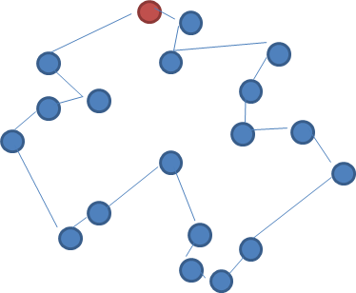
Individual decision making approaches
3. The Intuitive Decision Making Model
Experience and judgement vs. logic
Heuristics (‘rules of thumb’) “gut feeling”
A heuristic is any approach to problem solving, learning, or discovery that employs a practical method, not guaranteed to be optimal, perfect, logical, or rational, but instead sufficient for reaching an immediate goal.
E.g. Travelling Salesperson Problem (TSP)
Notes:
3. The Intuitive Decision Making Model
A final model that we review here - the intuitive decision making model emphasizes the decision maker's experience and judgement versus logic. According to this model, managers and other decision makers make their decisions using their "gut feeling", which comes from their accumulated experience from making similar and other experiences in the past. Because of this, they do not have to devote a lot of time surveying all possible alternative solutions for every decision - which would otherwise be infeasible. Instead, they use heuristics (or "rules of thumb") to quickly make decisions.
References
TSP:
Statement: a traveling seals man who supposes to travel all possible cities and then come home. in the field of operation research it ends up a very big problem. So they use heuristics to approximate solving the problem.
The point of this problem is that when you give it to people it just fits perfectly

Slide 18
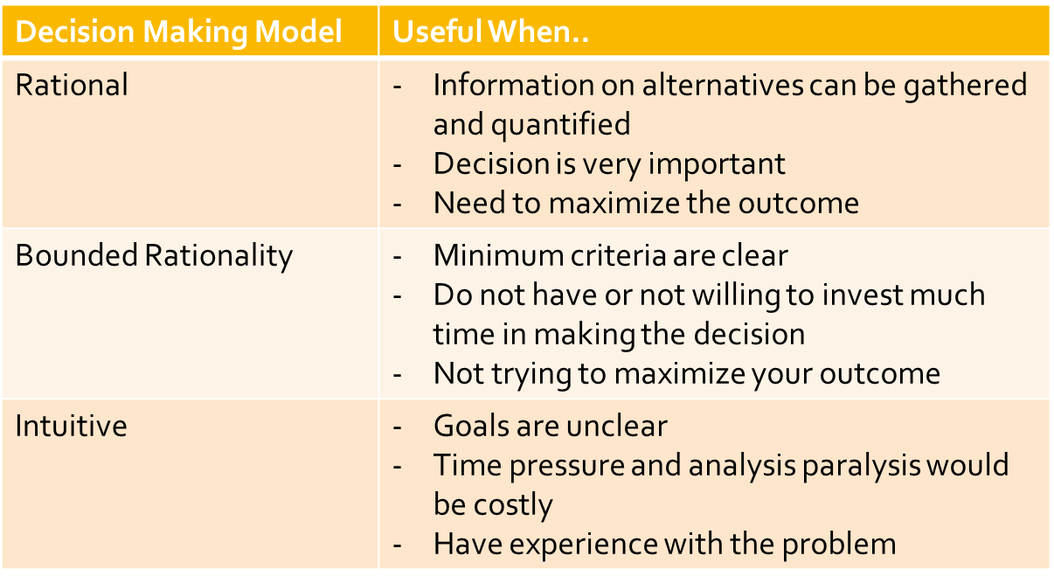
Comparing Decision Making Models

